Slide 1

PROBLEM STATEMENT TITLE: Waste Management
TEAM NAME: The Script Sirens
TEAM LEADER NAME: Vardaan Dwivedi
INSTITUTE CODE:U-0186
INSTITUTE NAME: JUIT SOLAN
THEME NAME: QR based complaint registration and community engagement
|

Slide 2
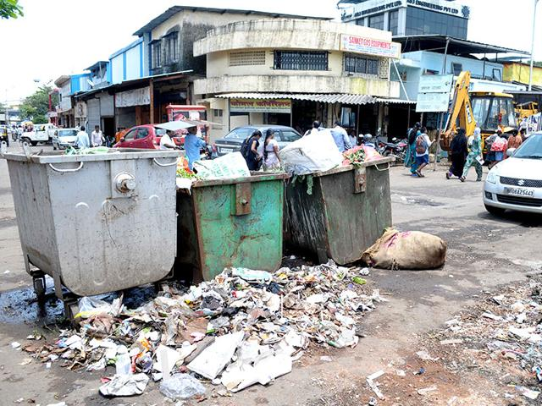
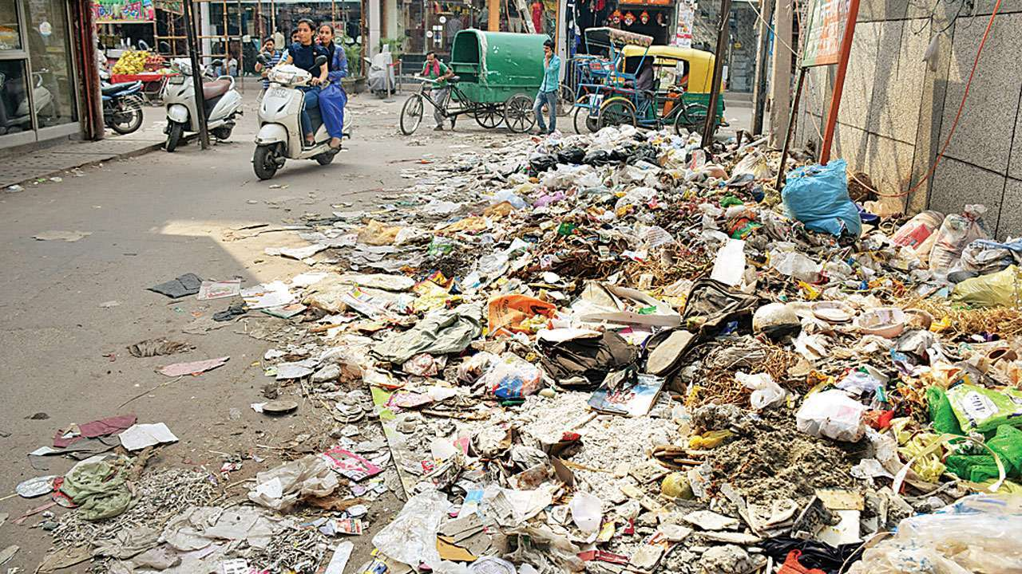

|

Slide 3
PROBLEMS FACED:
|
Improper Waste Disposal
Resistance to Behavioural Change
Lack of Community Engagement
Limited Technological Support
OUR SOLUTION

Slide 4
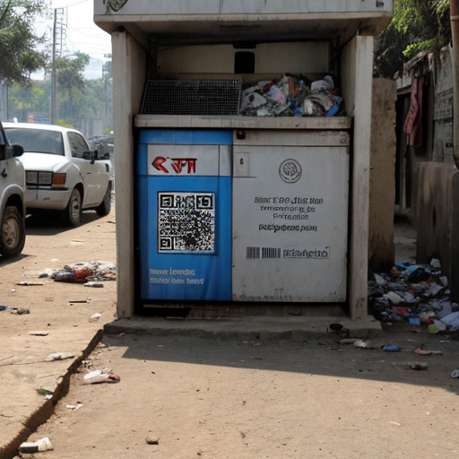
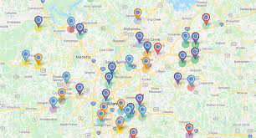
PROBLEMS FACED:
OUR SOLUTION
|
Improper Waste Disposal
Resistance to Behavioural Change
Lack of Community Engagement
Limited Technological Support
To create an accessible, frictionless complaint registration and community engagement web app.
Web App Flow

Slide 5
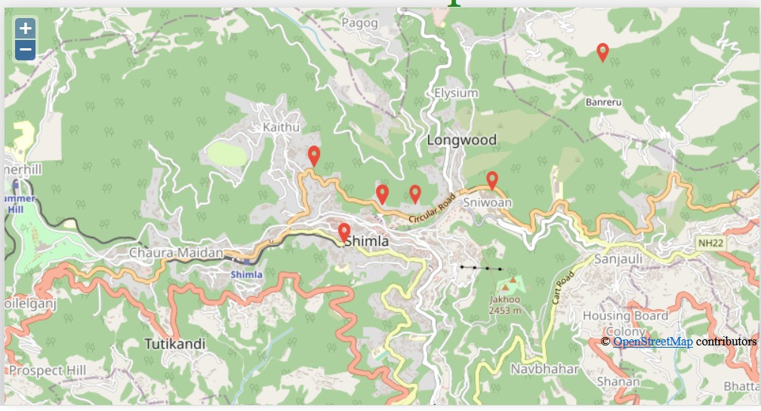
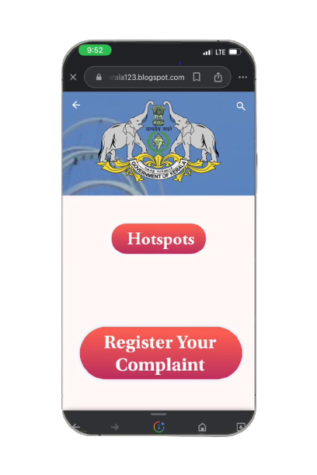
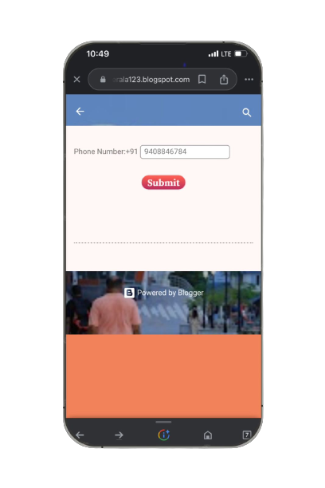
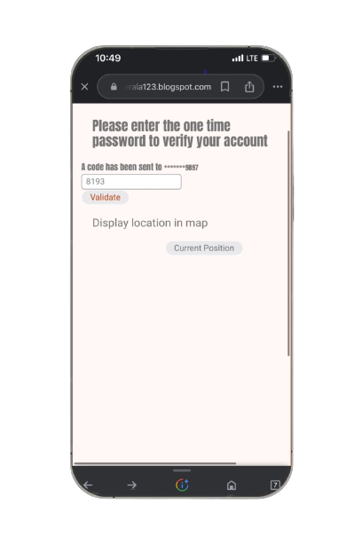
PROBLEMS FACED:
OUR SOLUTION
Web App Flow
|
Improper Waste Disposal
Resistance to Behavioural Change
Lack of Community Engagement
Limited Technological Support
To create an accessible, frictionless complaint registration and community engagement web app.

Slide 6
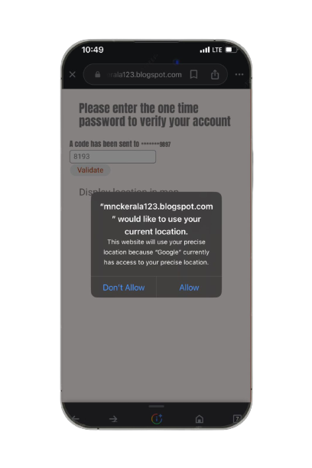
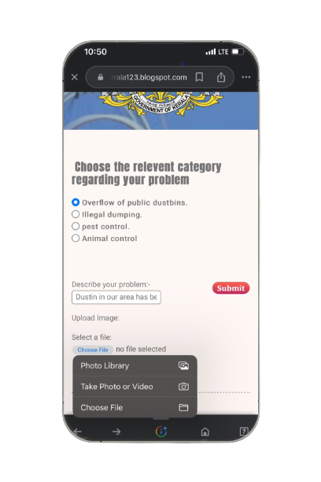
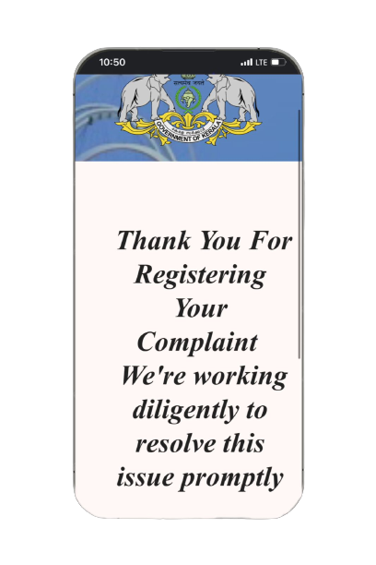
PROBLEMS FACED:
OUR SOLUTION
Web App Flow
|
Improper Waste Disposal
Resistance to Behavioural Change
Lack of Community Engagement
Limited Technological Support
To create an accessible, frictionless complaint registration and community engagement web app.

Slide 7

PROBLEMS FACED:
OUR SOLUTION
Web App Flow
HOTSPOTS
|
Improper Waste Disposal
Resistance to Behavioural Change
Lack of Community Engagement
Limited Technological Support
To create an accessible, frictionless complaint registration and community engagement web app.
A crowdsourced waste hotspot map for communities to locate piled up garbage spots and engage in community clean up drives.
VISION

Slide 8
PROBLEMS FACED:
OUR SOLUTION
Web App Flow
HOTSPOTS
|
Improper Waste Disposal
Resistance to Behavioural Change
Lack of Community Engagement
Limited Technological Support
To create an accessible, frictionless complaint registration and community engagement web app.
We collect the location data from the complaints and drop them as PINPOINTS on the map.
Allow people to scan through nearby affected areas to easily plan community clean up drives.
VISION

Slide 9
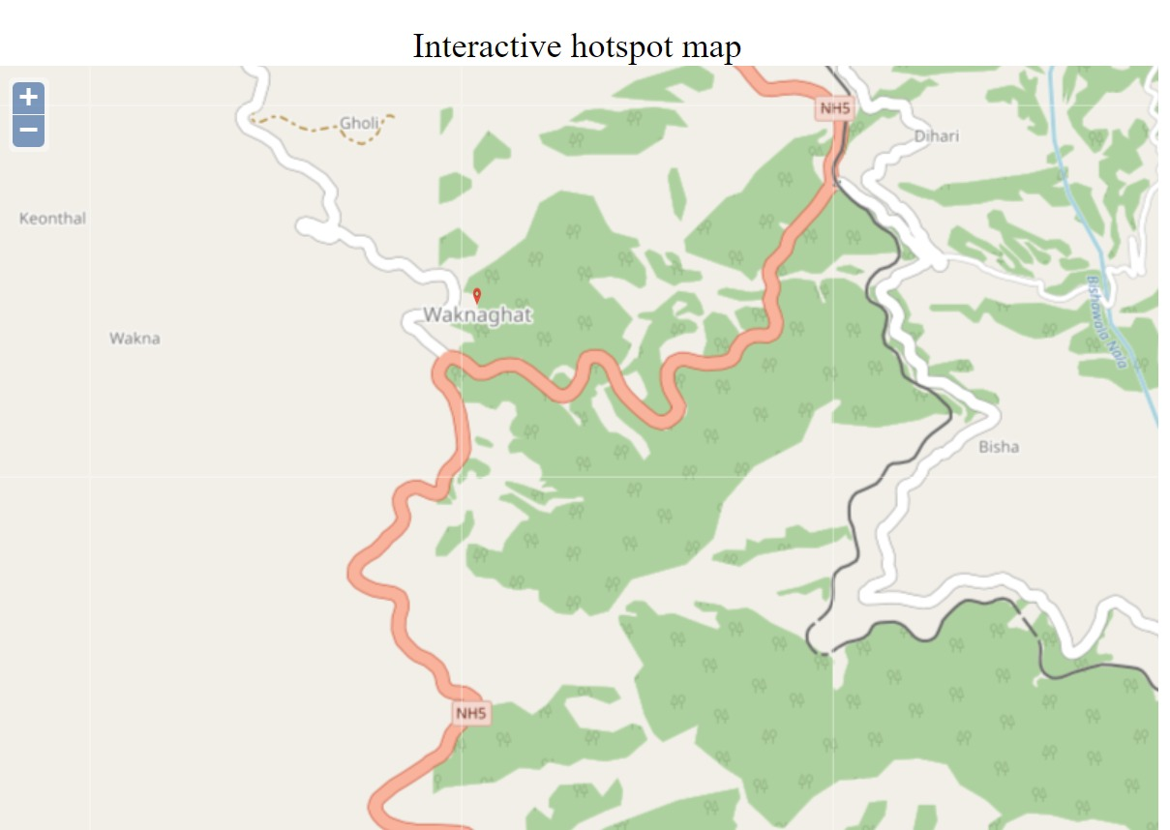
PROBLEMS FACED:
OUR SOLUTION
Web App Flow
VISION
HOTSPOTS
|
Improper Waste Disposal
Resistance to Behavioural Change
Lack of Community Engagement
Limited Technological Support
To create an accessible, frictionless complaint registration and community engagement web app.
GPS enabled garbage trucks for live monitoring and tracking of the fleet to show real time location.
Employee management software for logging of employee data and daily attendance using biometrics.
Providing a better blockchain enabled incentive driven model for people in community service.
A crowdsourced waste hotspot map for communities to locate piled up garbage spots and engage in community clean up drives.

Slide 10
Connecting More.........
Upon receiving a complaint, the system automatically identifies NGOs or clubs in the surrounding area actively involved in cleanliness drives. It then sends an email notification to all these identified organizations.
These NGOs and clubs are then encouraged to respond within 48 hours to express their interest in participating in a cleanup effort to address the complaint.

Slide 11
TEAM MEMBER DETAILS
Team leader Name: Vardaan Dwivedi
Branch :Btech stream: cse year:1st year
Member 1 Name: Saniya Gupta
Branch:Btech stream:cse year:1st year
Member 2 Name: Anvesha Vijan
Branch:Btech stream:cse year:1st year
Member 3 name : Shilpa Chauhan
Branch:Btech stream :cse year:1st year

